Slide 1
CSE 477: Introduction to Computer Security
Lecture – 5
Course Teacher: Dr. Md Sadek Ferdous
Assistant Professor, CSE, SUST
E-mail: ripul.bd@gmail.com

Slide 2
Outline
Basic crypto concepts
Other aspects

Slide 3
Cryptographic hash functions
To reduce the size of the message that Bob has to sign, we often use cryptographic hash functions, which are checksums on messages that have some additional useful properties
One-way: it should be easy to compute Y=H(M), but hard to find M given only Y
Collision-resistant: it should be hard to find two messages, M and N, such that H(M)=H(N)
Examples: SHA-1, SHA-256

Slide 4
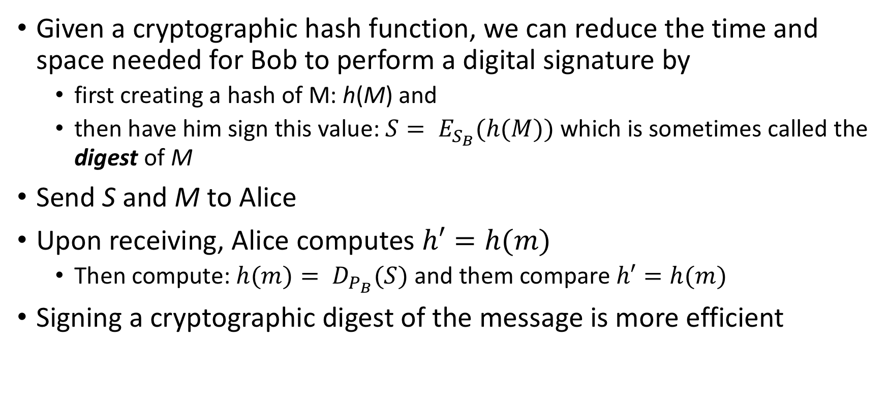
Cryptographic hash functions: applications
Given a cryptographic hash function, we can reduce the time and space needed for Bob to perform a digital signature by
first creating a hash of M: h(M) and
then have him sign this value: $S= E_{S_{B}}(h(M))$ which is sometimes called the digest of M
Send S and M to Alice
Upon receiving, Alice computes $h′=h(m)$
Then compute: $h(m)= D_{P_{B}}(S)$ and them compare $h′=h(m)$
Signing a cryptographic digest of the message is more efficient

Slide 5
Cryptographic hash functions: applications
Signing a cryptographic digest of the message also defends against the MITM attack described previously
both guarding integrity and authenticity of the message
Because it is no longer possible for the attacker to forge a message-signature pair without knowledge of the private key
Hence, if the attacker crafts a forged signature its validation will fail!
This guarantees authenticity of the message
Also, because of the collision-resistant property of the hash-function, the attacker cannot find another message M’ which will have the same digest as the M
This guarantees the integrity of the message

Slide 6
Cryptographic hash functions: applications
Another application of cryptographic hash functions is to protect the integrity of critical files in an operating system in the following way:
store the cryptographic hash value of each such file in protected memory
compute the cryptographic hash of a corresponding file in run-time
and compare the computed value with the stored in secure memory
if they match, the file has not been altered with, because of the collision-resistant property of the hash function

Slide 7
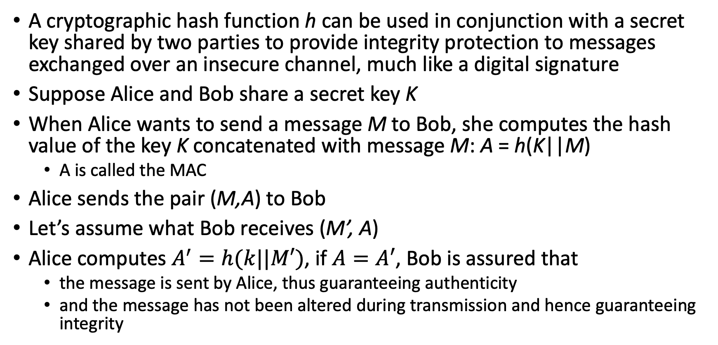
Message Authentication Code (MAC)
A cryptographic hash function h can be used in conjunction with a secret key shared by two parties to provide integrity protection to messages exchanged over an insecure channel, much like a digital signature
Suppose Alice and Bob share a secret key K
When Alice wants to send a message M to Bob, she computes the hash value of the key K concatenated with message M: A = h(K||M)
A is called the MAC
Alice sends the pair (M,A) to Bob
Let’s assume what Bob receives (M’, A)
Alice computes $A^{′}=h(k||M′)$, if $A=A′$, Bob is assured that
the message is sent by Alice, thus guaranteeing authenticity
and the message has not been altered during transmission and hence guaranteeing integrity

Slide 8
Message Authentication Code (MAC)

Slide 9
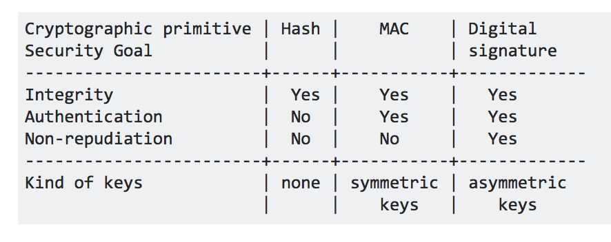
Digital Signature vs MAC
They are similar, but the shared key K needs to be exchanged in a secure fashion
Like any symmetric encryption
https://crypto.stackexchange.com/questions/5646/what-are-the-differences-between-a-digital-signature-a-mac-and-a-hash

Slide 10
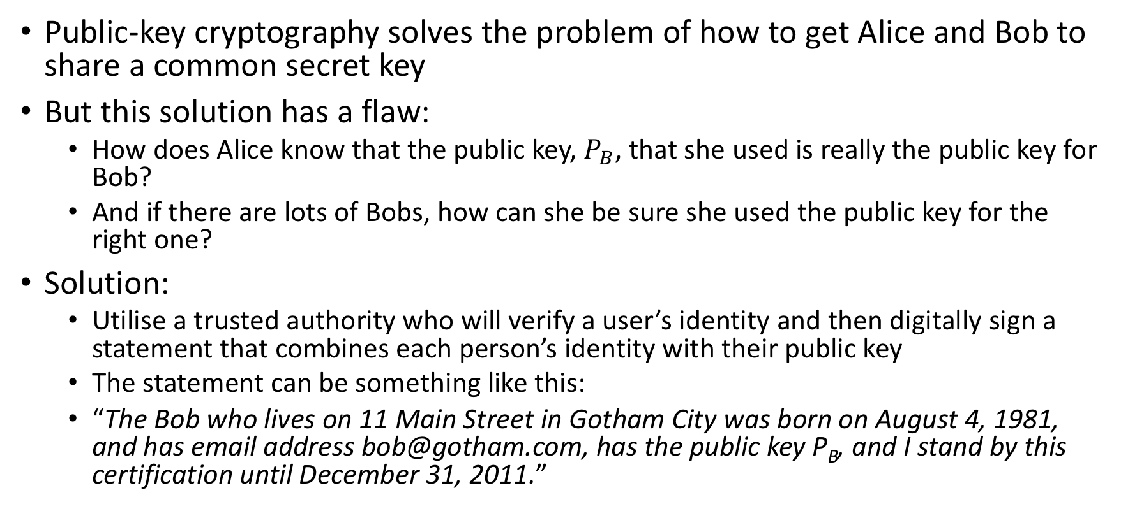
Digital certificates
Public-key cryptography solves the problem of how to get Alice and Bob to share a common secret key
But this solution has a flaw:
How does Alice know that the public key, $P_{B}$, that she used is really the public key for Bob?
And if there are lots of Bobs, how can she be sure she used the public key for the right one?
Solution:
Utilise a trusted authority who will verify a user’s identity and then digitally sign a statement that combines each person’s identity with their public key
The statement can be something like this:
“The Bob who lives on 11 Main Street in Gotham City was born on August 4, 1981, and has email address bob@gotham.com, has the public key P_{B}, and I stand by this certification until December 31, 2011.”

Slide 11
Digital certificates
Such a statement is called digital certificates
Such a trusted authority is called a Certificate Authority (CA)
Since the digital certificate is a strong evidence of the authenticity of Bob’s public key, Alice can trust it even if it comes from an unsigned email message or is posted on a third-party web site
However, Alice also needs to trust the public key of CAs. This creates a circular problem
Solution, embed the public keys of the CAs in the OS/Browser
We will study the protocol for validating digital certificates when we study web security

Slide 12
Digital certificates

Slide 13
Other aspects: passwords
A short sequence of characters used as a means to authenticate someone via a secret that they know (something you know paradigm)
Ideally, passwords should be easy to remember and hard to guess
Unfortunately, these two goals are in conflict with each other
Easy to remember passwords are easy to guess!
Hard random passwords are difficult to memorise!

Slide 14
Strong passwords
What is a strong password
UPPER/lower case characters
Special characters
Numbers
When is a password strong?
Seattle1
M1ke03
P@$$w0rd
TD2k5secV
An Example:
“Mark took Lisa to Disneyland on March 15,
MtLtDoM15,
MtL+DoM15, (a more secure password)

Slide 15
Password complexity
A fixed 6 symbols password:
Numbers: 10⁶ = 1,000,000
UPPER or lower case characters 26⁶ = 308,915,776
UPPER and lower case characters 52⁶ = 19,770,609,664
32 special characters (&, %, $, £, “, |, ^, §, etc.) 32⁶ = 1,073,741,824
94 practical symbols available 94⁶ = 689,869,781,056
ASCII standard 7 bit 2⁷ =128 symbols
128⁶ = 4,398,046,511,104 (4 trillion)
Odd characters make password safer!

Slide 16
Password length
94 characters:
26 UPPER/lower case characters=52characters
10 numbers
32 special characters
52 + 10 + 32 = 94 characters available

Slide 17
Secure passwords
A strong password includes characters from at least three of the following groups:

Slide 18
Dictionary attack
For the English language, there are less than 50,000 common words, 1,000 common human first names, 1,000 typical pet names, and 10,000 common last names
36,525 birthdays and anniversaries for almost all living humans
So an attacker can compile a dictionary of all these common passwords and have a file that has fewer than 100,000 entries
Armed with this dictionary of common passwords, one can perform an attack that is called, for obvious reasons, a dictionary attack
If a computer can test one password every millisecond, then it can complete the dictionary attack in 100 seconds, which is less than 2 minutes
Solution:
a certain number of password try within a certain duration
a certain number of tries before the account is locked

Slide 19
Other attacks
Social engineering refers to techniques involving the use of human insiders to circumvent computer security solutions
“Humans are the weakest link in the information security chain”
Pretexting: creating a story that convinces an administrator or operator into revealing secret information
I forgot my password and I have a meeting in 10 minutes. Could you please reset my password according to my choice?!
Baiting: offering a kind of “gift” to get a user or agent to perform an insecure action
Leaving a USB drive with text “top secret”!
Quid pro quo (“something for something.”): offering an action or service and then expecting something in return:
I am a helpdesk agent and your computer is in severe danger, let me help you!

Slide 20
Security usability
A secure system must be usable:
Remember security is often the secondary goal of a user
Security Usability:
A growing field combining the expertise of Security researchers, psychologists and computer engineering
Domain was created with the following seminal paper by Whitten et al.:
Why Johnny Can’t Encrypt at Usenix’99 – Study the paper
If you are more interested about passwords:
Passwords and the Evolution of Imperfect Authentication – Bonneau et al.
Homework: to read these two papers

Slide 21
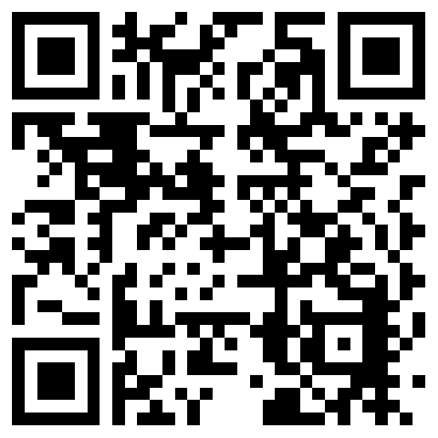
The lecture slides can be found in the following location!

